Slide 1
2019 Help A Hero
Preparation & PR

Slide 2

2019 HELp a hero overview
1,450 scholarships awarded totaling $6.5 million
Monday, October 14 – veterans day, Monday, November 11
2019 goal - $1.5 million
$880 per store/$32 per day
$1000 qualifies for heroes club
Top 5 stores win cash prizes
Notes:
-- stores can start fundraising early, but the kiosk donation screen will not be activated until Monday, October 14. Any funds collected early will need to be tracked on your own.
-- We strong encourage all stores to provide free haircuts on veterans day veterans, retired military and active duty.
--Also encourage all stores to add on the $1 per haircut service donation with their checks at the end of the promotion
--ALL FUNDS MUST BE SUBMITTED TO SCI by NOVEMBER 30. Please refer to pages 9-12 of the playbook for all the details on the program, submitting funds, etc.

Slide 3
Help A hero Contest details
Submit fundraising plans & store goals to SCI
Store is entered into drawing for a help a hero tablecloth & Help a hero shirt for manager
Email details to amanda.palm@sportclips.com by Friday, Sept. 20
Ten winners will be selected
Winners will be announced live on chad Jordan’s facebook page on Tuesday, sept. 24
Tablecloths & Shirts shipped to winning stores week of sept. 30
Notes:
Don’t forget to subit your store fundraising plan and goal by Friday, Sept 20
A simple email with “we plan to ask all clients for a donation, host a bake sale and our goal is $1000” Is all you need to send to be entered.

Slide 4

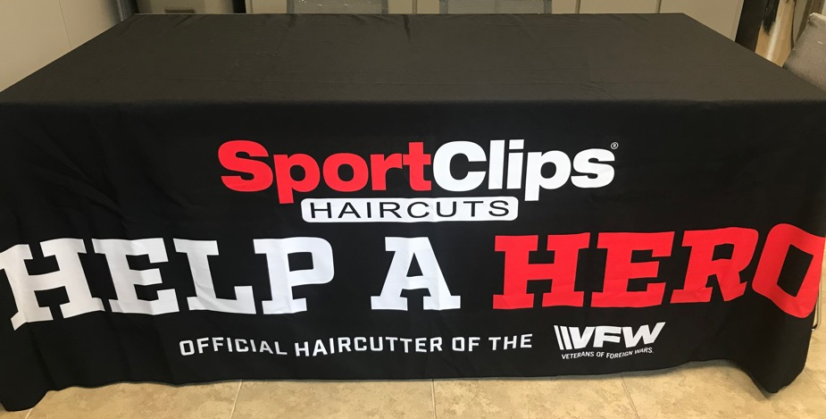
Contest prizes
Notes:
Each store will get one new tablecloth and a new Help A Hero shirt – which are now available for purchase on Boundless portal. The previous shirts are still approved for wear, but as inventory depletes, we are replacing with the updated shirt.

Slide 5
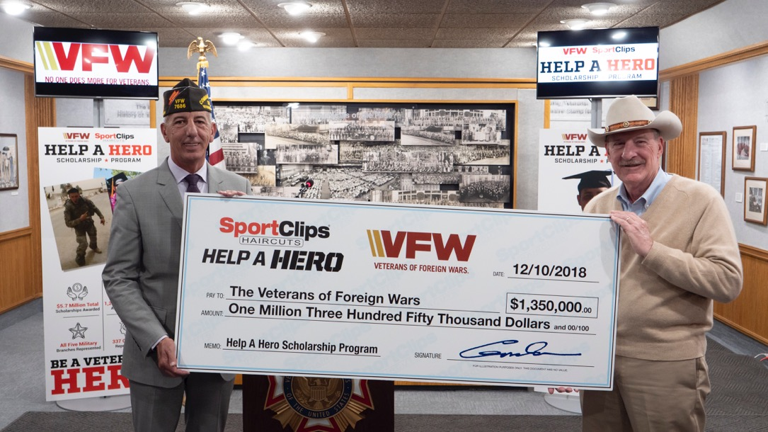
Fundraising ideas
Prize drawing
Pie in the face
Heroes week
Bake/Candy sales
Notes:
Going to highlight four simple options, but there are more in the Playbook. Also encourage you to reach out to the managers/Team Leaders of the Top 5 stores listed in the webinar. They are a great resource

Slide 6
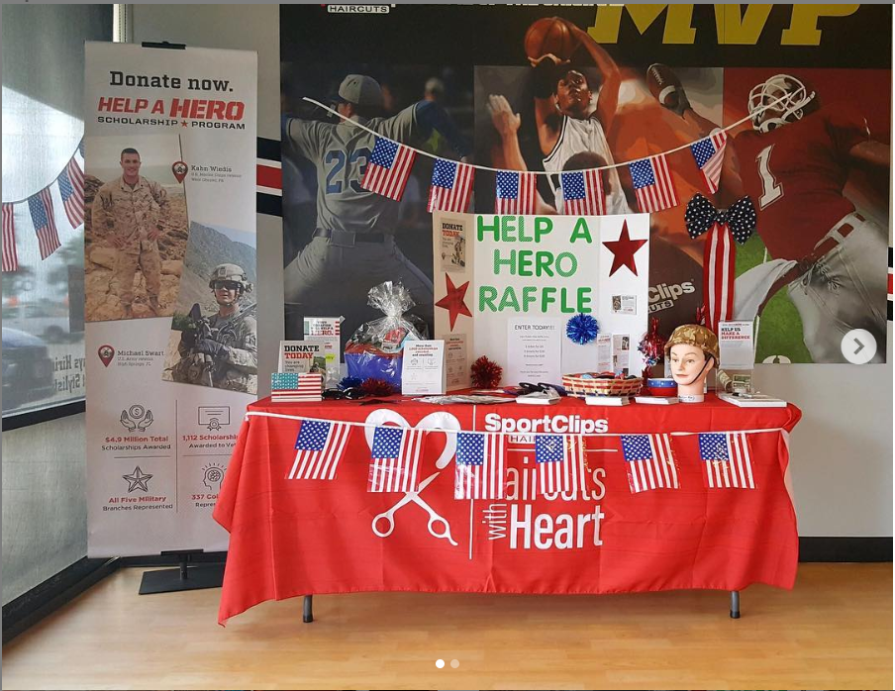
Prize drawing
Help a hero playbook – page 4
Solicit donations from businesses, friends, family, etc.
Promote in-store, social & email
Sell tickets for entries into drawing
Draw winners in-store
Notes:
Also called a raffle – a simple, fun way to collect funds and reward clients. Collect donations from other businesses in the community. Be sure to review the rules for your state regarding raffles as they can vary state-to-state and may require permitting.

Slide 7
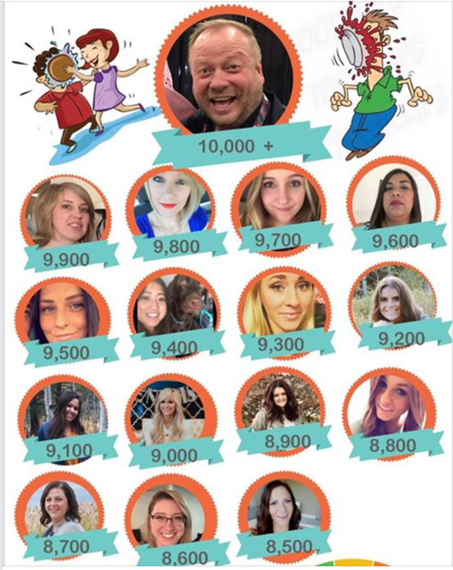
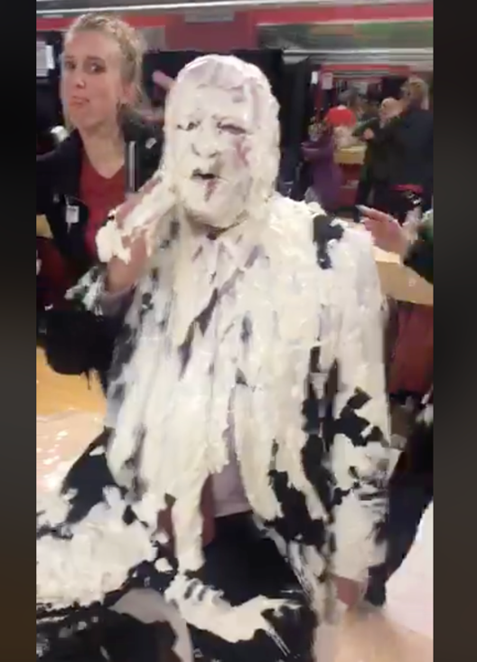
Pie in the face
Help A Hero Playbook – page 4
Set up a bag/bucket/basket for each team member
Sell tickets & clients drop tickets into the bag of the team member they want to pie in the face
Bag with most tickets ‘wins’
UT102 used this fundraiser & was the #3 store in 2018 with $10,397 raised

Slide 8
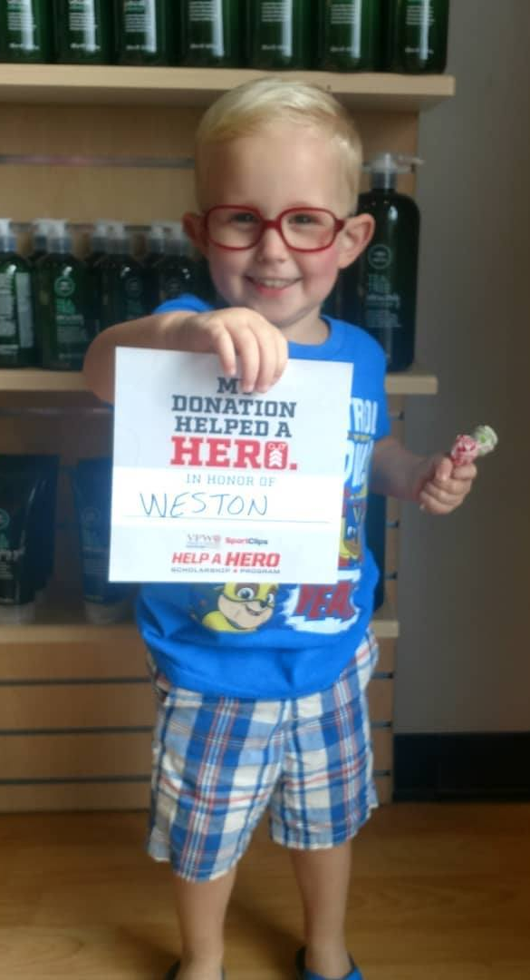
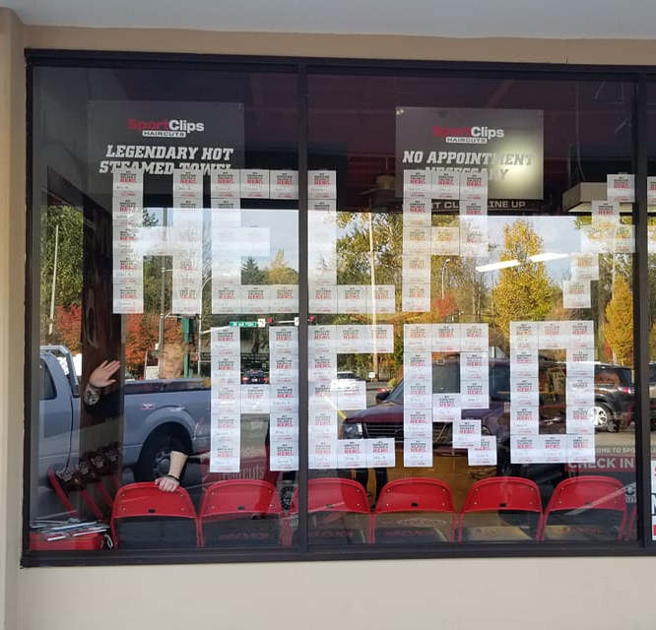
Heroes week
Help a hero playbook – page 5
Choose one week during the campaign
Offer free MVP Upgrades in exchange for donations
Promote in-store, social, local businesses, local VFW post
www.vfw.org/find-a-post
Customizable fliers on BAM online
Use the RECOGNITION CARDS

Slide 9
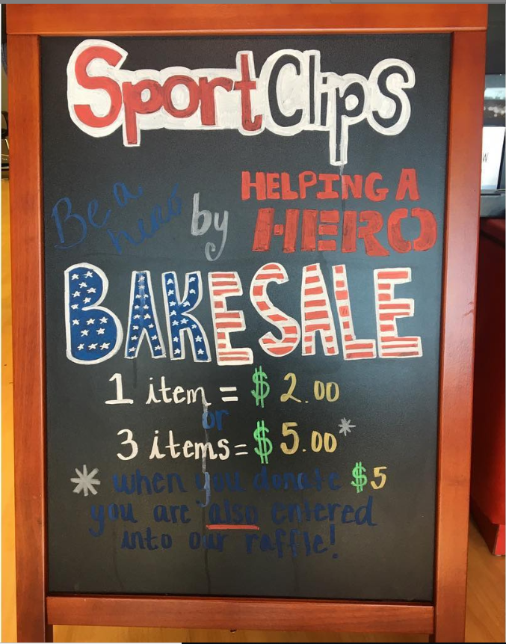
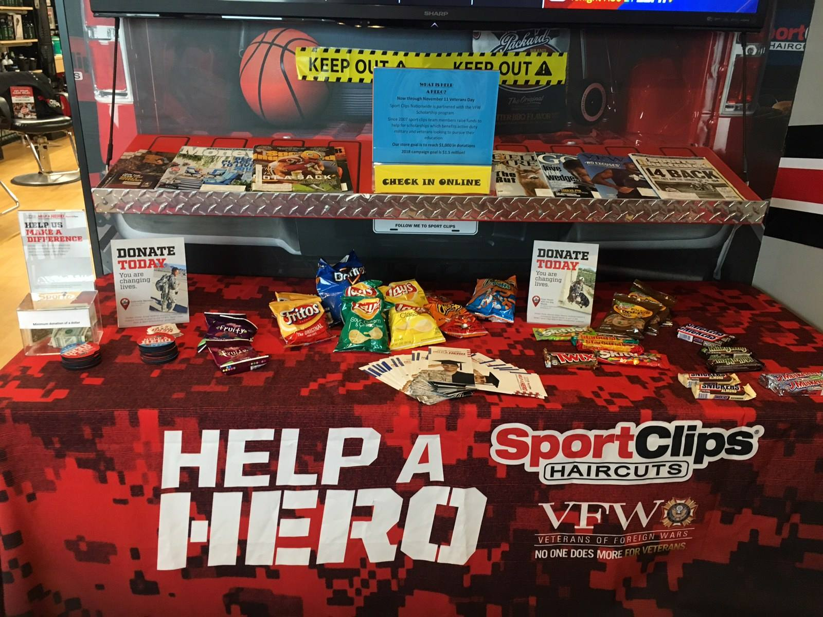
Bake/candy sales
Help A Hero Playbook – page 5
Have team members bring baked goods or purchase baked items/candy/drinks
Sell them to clients
all proceeds go to help a hero

Slide 10
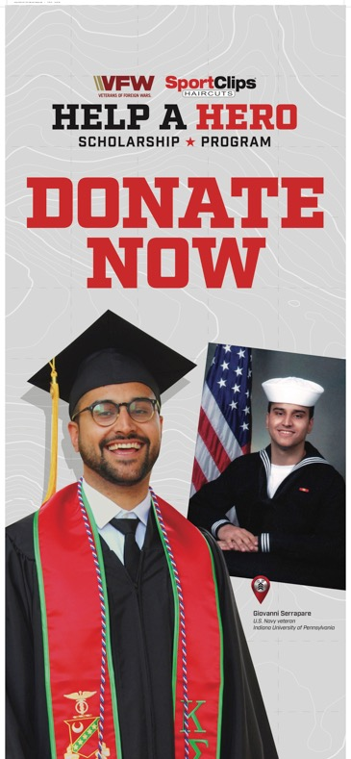
Help A Hero tools you can use
Business donation letter (receipt)
VFW Tax exempt form (501c3 form)
Templates – news releases, veterans day media alert, media outreach best practices
Prepped radio Q&A for DJs and news departments
Talking points
Contact information for Help a hero recipient in your area (if available)
Notes:
Everything listed here is on BAM Online under National Promotions – Help A Hero. There are also customizable creative pieces and you can always submit an ad request for a custom piece, but make sure to plan accordingly as custom ad requests can take up to 7 business days to complete.

Slide 11
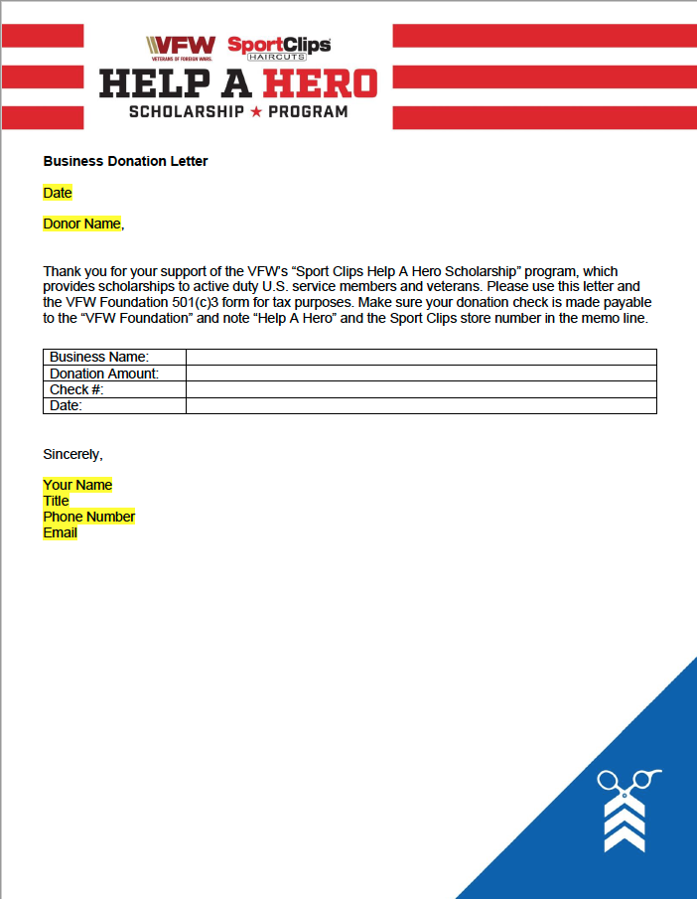
Business donation letter
Notes:
This letter should come from the TL and/or the store manager

Slide 12
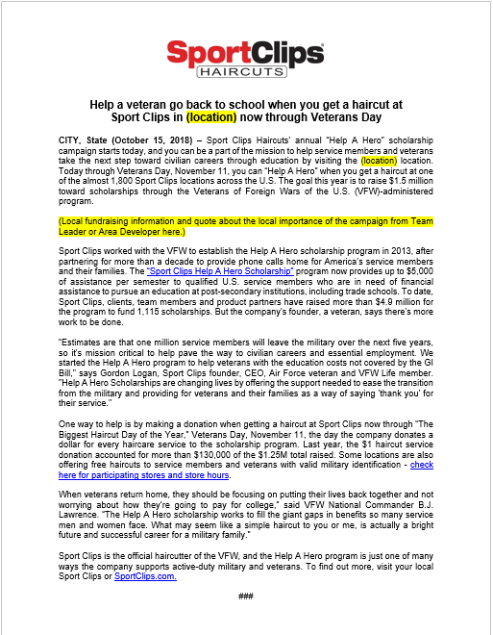
News release template

Slide 13
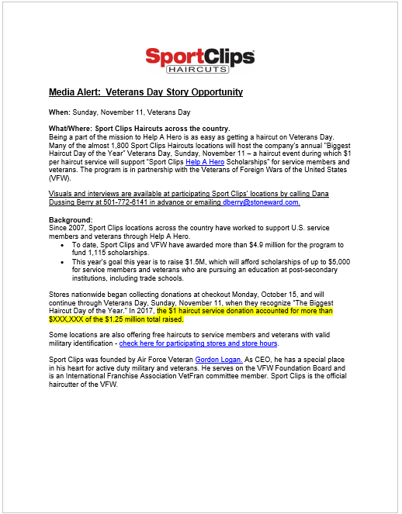
Media alert template

Slide 14
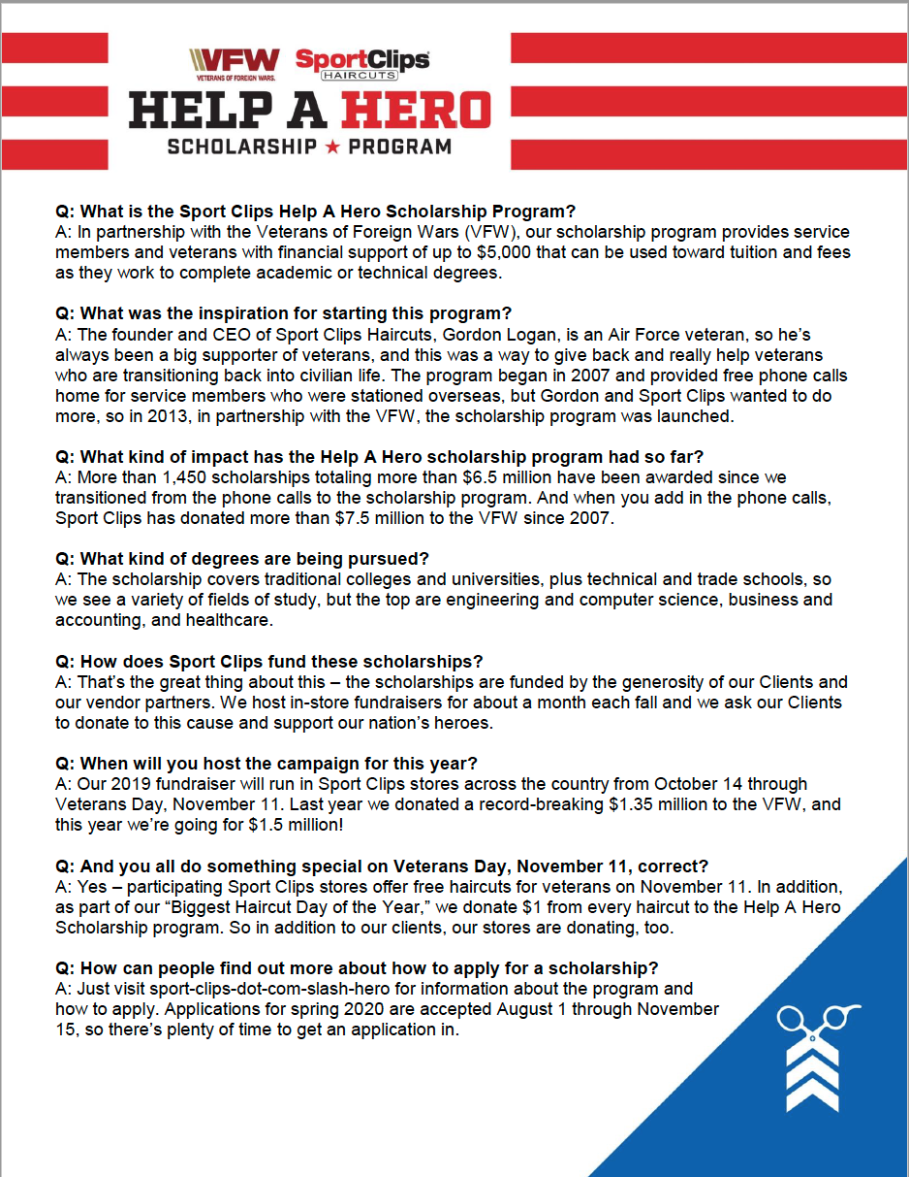
Q&A for Radio

Slide 15
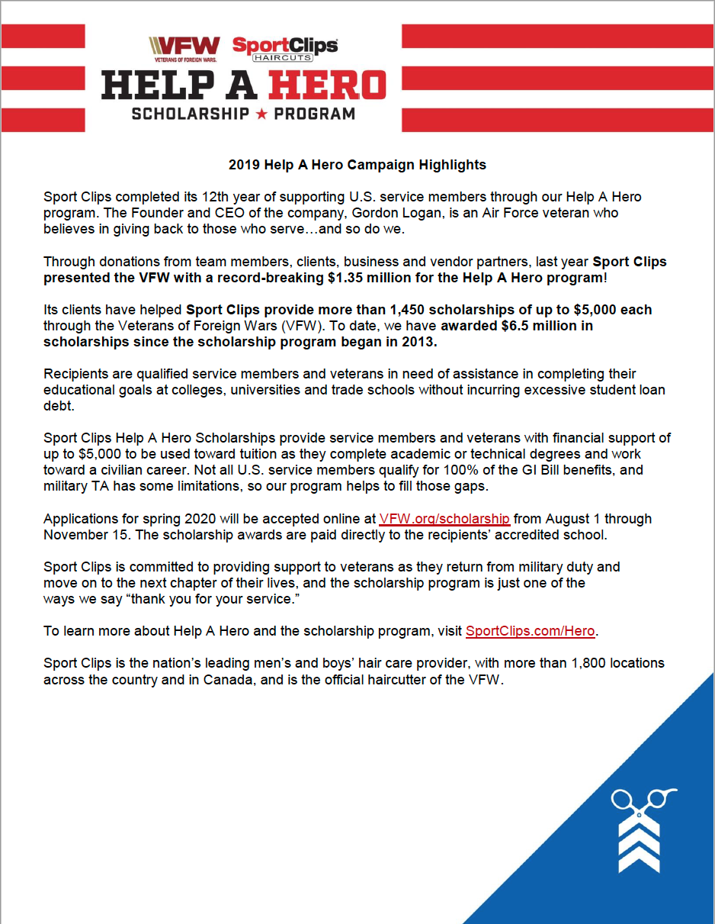
Talking points

Slide 16
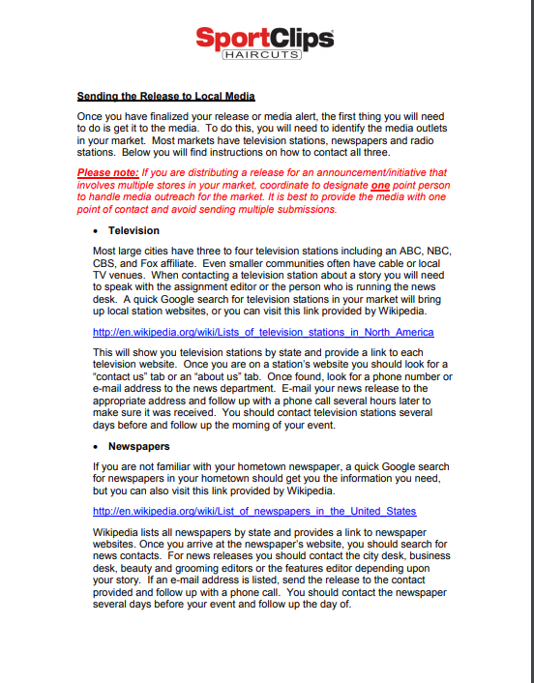
Media outreach best practices

Slide 17

Additional help a hero prep
Contact a help a hero recipient in your area (if available), to honor the recipient and work together on PR and outreach
Contact the local vfw post for opportunities to partner in promotion
Use the vfw tax (501c3) form available on bam online
If you partner with other businesses, use the business donation letter on bam online as a receipt for the donation

Slide 18
Make the most out of a media story
Prep your store & alert team members when a media interview is scheduled
If the interview is off-site, offer a visit to the store so the reporter/photographer/videographer can capture additional images
Tell clients in-store that a media interview will take place; if they are comfortable being on camera, ask them to complete a consent form
Depending on the focus of the story, practice responding to possible questions a reporter may ask. If the interview is on tv, practice in front of a mirror

Slide 19
Share! Share! Share!
Utilize your social channels, both business and personal (if comfortable), and tag appropriate media & businesses rather than individuals featured
It’s best to share directly from the website or social channel of the media outlet if possible. If not, copy & share the link to the story
Send media coverage to amanda palm at amanda.palm@sportclips.com
Don’t forget to tag @veterans of foreign wars VFW on facebook and @VFWhq on instagram

Slide 20
questions
Amanda Palm – amanda.palm@sportclips.com
Dana Dussing Berry – dberry@stoneward.com

